Slide 1
GNU/Linux System Support
CST8207
Week-1, L-2(b)
Sep 10, 2025
By: Gurpreet Singh Sidhu

Slide 2
Topics
File System Structure
Pathname Components
Types of Pathname

Slide 3
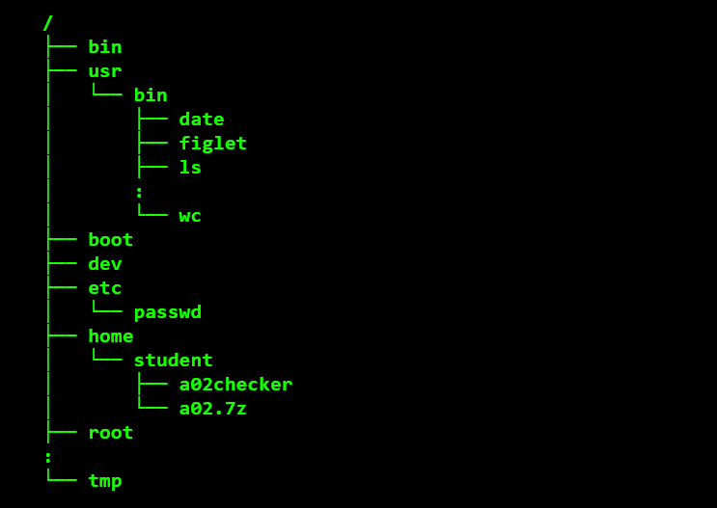
File System Structure
Unix/Linux files are organized within a single-tree hierarchical file system structure made up of files containing data (e.g. documents, programs), and directories (folders) that may contain other sub-directories and files.

Slide 4
No Loops or cycles
The directory structure in the file system is “acyclic” – following a path of directories down from the tree root into sub-directories will never lead you back toward the tree root into a “cycle” or loop.

Slide 5
Name components can contain any character except slash
Each file and directory has its own name.
The name of some object in the file system may contain any characters except the forward slashes (/)
The name may contain spaces, newlines, unprintable control characters, and characters from non-English languages.
Yes, you can have a file or directory name that is entirely made of blanks or backspace characters!
A single Linux name component is typically limited to 255 characters. Older Unix systems may have smaller limits.

Slide 6
Pathnames
(“path of names”) separated by forward slashes.
A Unix/Linux pathname is a text string made up of one or more names separated by forward slashes (/), e.g. /etc/passwd, /var/log/auth.log
A pathname is a path-of-names that indicates how to find something in the hierarchical file system tree
The pathname text string will contain, in order, the directories you need to go through to arrive at the destination. To do this, the pathname text string lists one or more name components separated by forward slashes, e.g. /etc/passwd, /usr/bin/wc.
NOTE:- slashes are used to separate the names in pathname text strings.

Slide 7
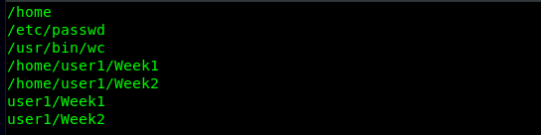
Examples of pathnames

Slide 8
Absolute and Relative pathnames
Pathnames come in two flavours:
Absolute pathname
Relative pathname

Slide 9
Absolute pathname
Absolute pathnames start with a slash on the left.
Absolute pathnames always start with this topmost ROOT directory slash and descend through every directory name that leads down to the destination.
Absolute pathnames always refer to the same, unique destination, since absolute pathnames always start with the topmost ROOT slash and don’t depend on the current directory of a process.
Example
/home/user1/Week1
/usr/bin/grep
/etc/passwd
/home

Slide 10
Relative pathnames
Relative pathnames do not start with a slash.
A relative pathname is used along with the current working directory to avoid typing long pathnames.
Relative pathnames always start in the current directory of a process, so the final destination changes depending on the current directory
A relative pathname never starts with a slash on the left, but it may contain slashes anywhere else: /bar is not relative (it is an absolute pathname) but home , home/ , ./home , ../home , home/Week1 are all relative pathnames.

Slide 11
Examples
Current Working Directory | Relative Path/Pathname | Absolute Path
/home | user1 | /home/user1
/home | user1/Week1 | /home/user1/Week1
/usr | bin | /usr/bin
/user | . | /user/.
/user/bin | /bin | /bin
/home | ../etc | /home/../etc
/home | .. | /home/..
/home | /bin | /bin
The pathname /bin is unchanged, since it is not a relative pathname.

Slide 12
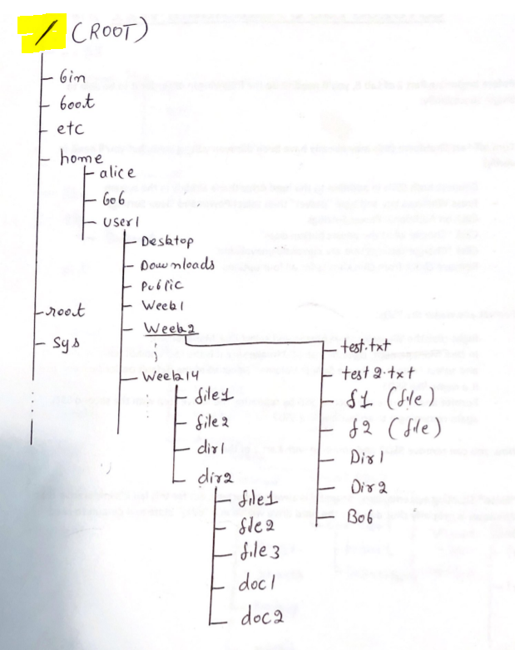
Practice

